Slide 1
Sorting and Searching
T.Anil kumar
COMPUTER SCIENCE & ENGINEERING
IIIT SRIKAKULAM

Slide 2
Sorting means arranging the elements of an array so that they are placed in some relevant order which may be either ascending or descending .
That is if A is an array ,then the elements of A are arranged in a sorted order (ascending order) in such a way that A[0]<A[1]<A[2]<………<A[N].
For example ,if we have an array that is declared and initialized as
int A[]={21,34,11,9,1,0,22};
Then the sorted array (ascending order) can be given as:
A[]={0,1,9,11,21,22,34};

Slide 3
A sorting algorithm is defined as an algorithm that puts the elements of a list in a certain order, which can be either numerical order, lexicographical order, or any user defined order.
Efficient sorting algorithms are widely used to optimize the use of other use of other algorithms like search and merge algorithms which require sorted lists to work correctly.
There are two types of sorting:
Internal sorting: which deals with sorting the data stored in the computer’s memory.
External sorting: which deals with sorting the data stored in files.
External sorting is applied when there is voluminous data that cannot be stored in the memory.

Slide 4
Types of Sorting Techniques:
1.Bubble Sort
2.Insertion Sort
3.Selection Sort
4.Quick Sort
5.Merge Sort
6.Heap Sort
7.Counting sort
8.Radix sort
9.Shell sort……….etc

Slide 5
1: Bubble Sort:
Bubble Sort Algorithm is used to arrange N elements in particular order, and for that, you have to begin with 0th element and compare it with the first element.
If the 0th element is found greater than the 1st element, then the swapping operation will be performed, i.e., the two values will get interchanged. In this way, all the elements of the array get compared.
Bubble sort is the simplest algorithm of all. It begins by comparing every pair of adjacent elements of an array and checks if the first element is greater than the second.
If so, then the two elements must be swapped. Else they need not be swapped and moves on to the next element. This process goes on until the last and second last element is compared.

Slide 6
Bubble sort examples:
4,9,5,1,0
14,33,27,35,10
5,1,6,2,4,3
3,60,35,2,45,320,5

Slide 7
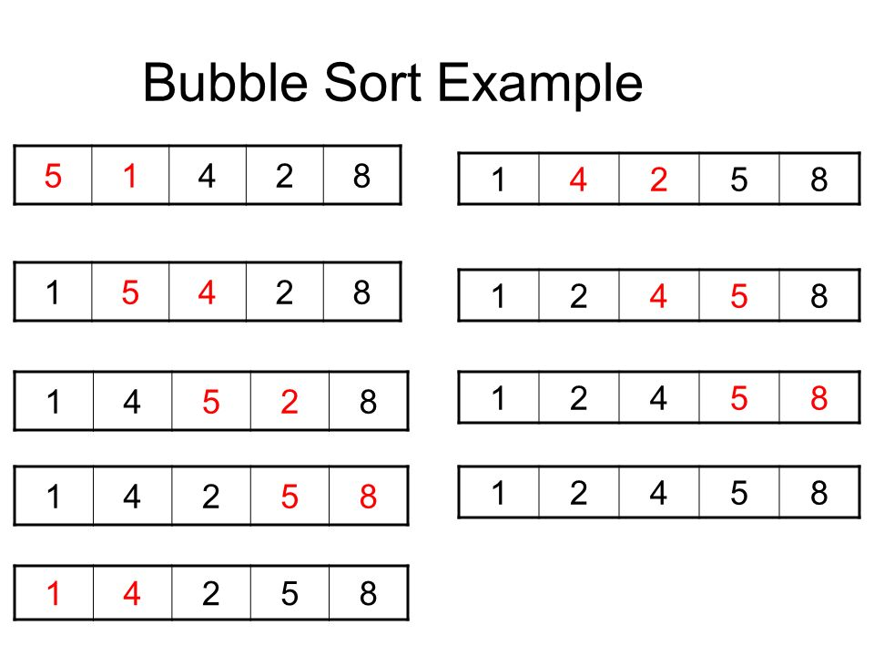

Slide 8
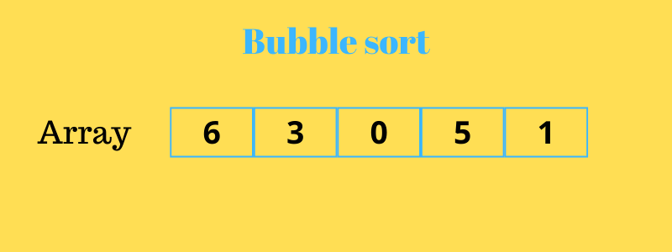
Fig: Example of bubble sort

Slide 9

Fig: Example of bubble sort

Slide 10
Exercise problems:
5,1,4,2,8
40,10,20,30,50
42,35,12,77,5,101
2,7,4,1,5,3
8,4,6,9,2,3,1
7,5,2,4,10,1,6,3
9,6,2,12,11,8,3,7

Slide 11
Bubble sort Algorithm:
Bubble sort(A,N)
Step1: repeat step 2 for i=0 to n-1
Step 2: repeat for j=0 to n-i-1
Step 3: if(A[j]>A[j+1])
swap A[j] and A[j+1]
end of inner for loop
end of outer loop
Step 4:exit

Slide 12
Logic for bubble sort:
for (i=0;i<n-1;i++)
{
for (j=0;j<n-i-1;j++)
{
if (array[j] > array[j+1])
{
temp=array[j];
array[j]=array[j+1];
array[j+1]=temp;
}
}
}

Slide 13


Slide 14
Insertion sort:
Insertion sort is a very simple sorting algorithm in which the sorted array(or list) is built one element at a time.
We all familiar with this technique of sorting, as we usually use it for ordering a deck of cards while playing bridge.
The main idea behind insertion sort is that in inserts each item into its proper place in the final list.
To save memory ,most implementations of the insertion sort algorithm work by moving the current data element past the already sorted values and repeatedly interchanging it with the preceding value until it is its correct place.
Insertion sort is less efficient as compared to other more advanced algorithms such as quick sort, heap sort and merge sort.

Slide 15
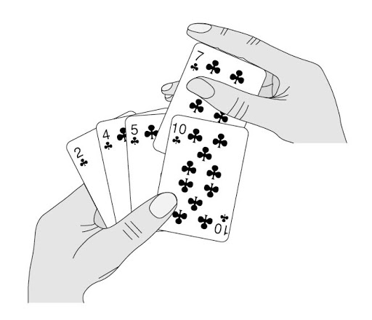
Fig: Example insertion sort

Slide 16
Insertion sort works as follows:
The array of values to be sorted is divided into two sets. One that stores sorted values and another that contains unsorted values.
The sorting algorithm will proceed until there are elements in the unsorted set.
Suppose there are n elements in the array. Initially, the element with index 0(assuming LB=0) is in the sorted set. Rest of the elements are in the unsorted set.
The first element of the unsorted partition has array index 1(if LB=0)
During each iteration of the algorithm, the first element in the unsorted set is picked up and inserted into the correct position in the sorted set.

Slide 17
Insertion sort Algorithm:
INSERTION SORT(ARR,N)
Step 1: repeat steps 2 to 5 for i=1 to n-1
Step 2: SET temp =ARR[i]
Step 3: SET j=i
Step 4: Repeat while j>0 && ARR[j-1]>temp
SET ARR[j]=ARR[j-1]
SET j=j-1
[End of Inner loop]
Step 5: SET ARR[j]=temp
[End of loop]
Step 6: Exit

Slide 18
Advantages of insertion sort:
It is easy to implement and efficient to use on small sets of data.
It can be efficiently implemented on data sets that are already substantially sorted.
It performs better than algorithms like selection sort and bubble sort.
Insertion sort is simpler than shell sort,with only a small trade-off in efficiency.
(iv) It is over twice as fast as the bubble sort and almost 40% faster than selection sort.
(v) It requires less memory space (only o(1) of additional memory space).

Slide 19

Fig: Example of insertion sort

Slide 20
Insertion sort examples:
9,5,1,4,3
4,3,-1,2,1
5,1,6,2,4,3
8,7,5,2,4,6,3
4,3,2,10,12,1,5,6

Slide 21
Exercise problems:
1) 5,3,8,4,6
2) 8,5,7,1,9,3
3)5,2,6,1,3,9
4) 17,26,54,77,93,31,44,55,20
5) 10,30,80,20,60,40,50

Slide 22
Selection sort:
Selection sort is a sorting algorithm that has a quadratic running time complexity of O(n^2),thereby making it inefficient to be used on large lists.
Although selection sort performs worse than insertion sort algorithm, it is noted for its simplicity and also has performance advantages over more complicated algorithms in certain situations.
Selection sort is generally used for sorting files with very large objects(records) and small keys.

Slide 23
Selection sort work as follows:
Consider an array ARR with N elements. First find the smallest value in the array and place it in the first position.Then,find the second smallest value in the array and value it in the second position. Repeat this procedure until the entire array is sorted. Therefore,
(i) In Pass 1,find the position POS of the smallest value in the array and then swap ARR[POS] and ARR[0].Thus,ARR[0] is sorted.
(ii) In Pass 2,find the position POS of the smallest value in sub-array of N-1 elements. Swap ARR[POS] with ARR[1].Now,ARR[0] and ARR[1] is sorted.
(iii) In Pass N-1,find the position POS of the smaller of the elements ARR[N-2] and ARR[N-1].Swap ARR[POS] and ARR[N-2] so that ARR[0],ARR[1],………………ARR[N-1] is sorted.

Slide 24
Advantages of selection sort:
(i) It is simple and easy to implement.
(ii) It can be used for small data sets.
(iii) It is 60% more efficient than bubble sort.
However, in case of large data sets, the efficiency of selection sort drops as compared to insertion sort.

Slide 25
Selection sort(ARR,N)
Step 1:Repeat 2 and 3 for i=1 to N-1
Step 2: CALL Smallest (ARR,i,N,POS)
Step 3: Swap A[i] with ARR[POS]
[End of loop]
Step 4: Exit
Smallest(ARR,i,N,POS)
Step 1: [INITIALIZE] SET Small=ARR[i]
Step 2: [INITIALIZE] SET POS=i
Step 3: Repeat for j=i+1 to N-1
if ARR[J]<Small
SET Small =ARR[j]
SET POS=j
[End of if]
[End of Loop]
Step 4: Return POS

Slide 26
Examples of Selection sort:
1) 20,30,10,50,40
2) 5,2,4,6,1,3
3) 20,12,10,15,2
4) 17,16,3,13,6
5) 15,20,18,25,22,34,13

Slide 27
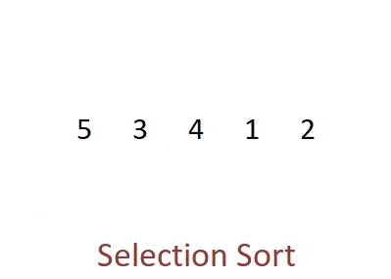
Fig: Example of selection sort

Slide 28
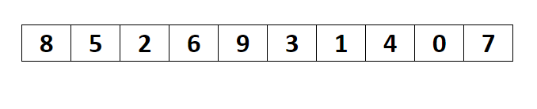
Fig: Example of selection sort

Slide 29
Exercise problems:
1) 7,3,2,8,1
2) 7,4,10,8,3,1
3) 2,7,4,1,5,3
4) 9,3,1,4,2,7,5
5) 39,9,81,45,90,27,72,18
6) 2,5,6,7,8,12,34,20,1,67

Slide 30
Merge sort:
Merge sort is a sorting algorithm that uses the divide,conquer,and combine algorithmic paradigm..
Divide means partitioning the n-element array to be sorted into two sub-array of n/2 elements. If A is an array containing zero or one element, then it is already sorted.However,if there are more elements in the array,divide A into two sub-arrays, A1 and A2, each containing about half of the elements of A.
Conquer means sorting the two sub-arrays recursively using merge sort.
Combine means merging the two sorted sub-arrays of size n/2 to produce the sorted array of n elements.

Slide 31
Merge sort algorithm focuses on two main concepts to improve its performance(running time):
(i) A smaller list takes fewer steps and thus less time to sort than a large list.
(ii) As no. of steps is relatively less,thus less time is needed to create a sorted list from two sorted lists rather than creating it using two unsorted lists.
The basic steps of a merge sort algorithm are as follows:
(i) If the array is of length 0 ot 1,then it is already sorted.
(ii) Otherwise ,divide the unsorted array into two sub-arrays of about half the size.
(iii) Use merge sort algorithm recursively to sort each sub-array..
(iv) Merge the two sub-arrays to form a single sorted list.

Slide 32
The merge sort algorithm uses a function merge which combines the sub-arrays to form a sorted array. While the merge sort algorithm recursively divides the list into smaller lists, the merge algorithm conquers the list to sort the elements in individual lists. Finally,the smaller lists are merged to form one list.
Merge sort Algorithm:
Merge sort(ARR,BEG,END)
Step 1: IF BEG < END
SET MID=(BEG+END)/2
CALL MERGE_SORT(ARR,BEG,MID)
CALL MERGE_SORT(ARR,MID+1,END)
MERGE(ARR,BEG,MID,END)
[END OF IF]
Step 2: END

Slide 33
Examples of Merge sort:
6,5,12,10,9,1
6,3,5,1,8,2,4,7
38,27,43,3,9,82,10,24
12,23,2,43,51,35,19,4
5,12,4,1,2,8,7,6,10

Slide 34
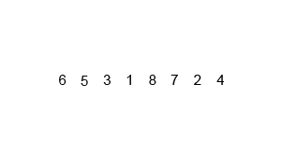
Fig: Example of merge sort

Slide 35
Exercise problems:
98,1,45,13,6,9
10,6,8,5,7,3,4
14,7,3,12,9,11,6,2
6,42,2,32,15,8,23,4
6,1,4,3,5,7,9,2,8,0
39,9,81,45,90,27,72,18

Slide 36
Quick sort:
Quick sort is widely used sorting algorithm developed by C.A.R.Hoare that makes o(n log n ) comparisons in the average case to sort an array of n elements.
However, in the worst case, it has a quadratic running time given as O(n^2)
Basically, the quicksort algorithm is faster than other o(n log n) algorithms, because its efficient implementation can minimize the probability of requiring quadratic time.
Quick sort is also known as partition exchange sort.
Like merge sort, this algorithm works by using divide –and conquer strategy to divide a single to divide a single unsorted array into two smaller sub-arrays.

Slide 37
The quick sort algorithm works as follows:
Select an element pivot from the array elements.
Rearrange the elements in the array in such way that all elements that are less than the pivot appear before the pivot and all elements greater than the pivot element come after it(equal values can go either way). After such a partitioning, the pivot is placed in its final position. This is called the partition operation.
Recursively sort the two sub-arrays thus obtained.(One with sub-list of values smaller than that of the pivot element and the other having higher value elements.)

Slide 38
Like merge sort, the base case of the recursion occurs when the array has zero or one element because in that case the array is already sorted. After each iteration, one element(pivot) is always in its final position. Hence, with every iteration, there is one less element to be sorted in the array.
Thus, the main task is to find the pivot element, which will partition the array into two halves. To understand how we find the pivot element, follow the steps given below.(we take the first element in the array as pivot.)

Slide 39
Quick sort simple steps:
We follow three steps recursively:
Find pivot that divides the array into two halves.
Quicksort the left half.
Quicksort the right half.

Slide 40
Quicksort partition algorithm:
while(i<j)
{
while(a[i]<=pivot)
{
i++;
}
while(a[j]>pivot)
{
j--;
}
if(i<j)
{
swap(a[i],a[j])
}
swap(pivot,a[j])

Slide 41
Quick sort works as follows:
Set the index of the first element in the array to loc and left variables. Also, set the index of the last element of the array to the right variable.
That is, loc= 0,left =0,and right=n-1(where n in the no of elements in the array).
2. Start from the element pointed by right and scan the array from right to left, comparing each element on the way with the element pointed by the variable loc. That is, a[loc]should be less than a[right].
If that is the case, then simply continue comparing until right becomes equal to loc.Once right=loc,it means the pivot has been placed in its correct position.
However, if at any point, we have a[loc]>a[right],then interchange the two values and jump to step 3.
set loc=right

Slide 42
3. Start from the element pointed by left and scan the array from left to right,comparing each element on the way with the element pointed by loc. That is, a[loc] should be greater than a[left].
If that is the case, then simply continue comparing until left becomes equal to loc. Once left=loc, it means the pivot has been placed in its correct position.
However, if at any point,we have a[loc]<a[left],then interchange the two values and jump to step 2.
set loc=left.

Slide 43
Quicksort examples:
10,-3,11,12,4
5,2,6,1,3,4
2) 5,7,3,2,10,1
3) 6,3,7,2,4,5
4)50,40,10,60,70,30

Slide 44

Fig: Example of Quicksort

Slide 45
Exercise problems:
50,40,10,30,20
6,3,7,2,4,5
6,5,3,1,8,7,2,4
35,33,42,10,14,19,27,44,26,31
10,15,1,2,9,16,11

Slide 46
Counting sort:
Counting sort is a sorting algorithm that sorts the elements of an array by counting the number of occurrences of each unique element in the array.
The count is stored in an auxiliary array and the sorting is done by mapping the count as an index of the auxiliary array.
Counting sort is a stable sorting technique, which is used to sort objects according to the keys that are small numbers. It counts the number of keys whose key values are same.
This sorting technique is effective when the difference between different keys are not so big, otherwise, it can increase the space complexity.

Slide 47
How Counting Sort Works?
Find out the maximum element (let it be max) from the given array.
Initialize an array of length max+1 with all elements 0.
This array is used for storing the count of the elements in the array.
3.Store the count of each element at their respective index in count array. For example: If the count of element “4” occurs 2 times then 2 is stored in the 4th position in the count array.
If element “5” is not present in the array, then 0 is stored in 5th position.

Slide 48
4. Store cumulative sum of the elements of the count array. It helps in placing the elements into the correct index.
5. Find the index of each element of the original array in count array.
This gives the cumulative count. Place the element at the index calculated.
6.After placing each element at its correct position, decrease the its count by one.

Slide 49
Counting Sort Algorithm:
counting Sort(array, size)
max <- find largest element in array
initialize count array with all zeros
for j <- 0 to size
find the total count of each unique element and
store the count at jth index in count array
for i <- 1 to max
find the cumulative sum and store it in count array itself
for j <- size down to 1
restore the elements to array
decrease count of each element restored by 1

Slide 50
Examples of counting sort:
1) 4,2,3,2,8,3,1
2) 5,6,4,5,0,1,3,5
3) 9,6,4,3,8,3,6,9
4) 2,5,6,2,3,10,3,6,7,8

Slide 51
Exercise problems:
1) 1,0,3,1,3,1
2) 4,1,7,2,1,5,2
3) 4,3,0,2,1,7,5,4
4) 5,6,8,7,9,0,1,4,3,6,3,7,6
5) 3,6,4,1,3,4,1,4,

Slide 52
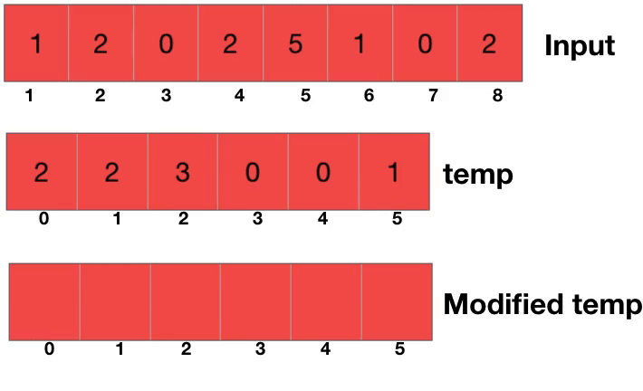
Fig: Example of counting sort

Slide 53
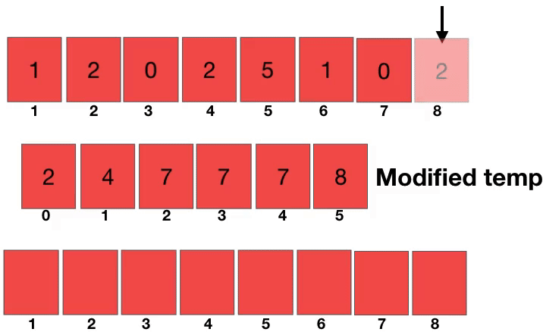
Fig: Example of counting sort

Slide 54
Radix sort:
Radix sort is a linear sorting algorithm for integers and uses the concept of sorting names in alphabetical order.
When we have a list of sorted names, the radix is 26(or 26 buckets) because there are 26 letters in the English alphabet .So radix sort is also known as bucket sort.
Observe the words are first sorted according to the first letter of the name. That is,26 classes are used to arrange names, where the first class stores the names that begin with A,the second class contains the names with B, and so on..

Slide 55
During the second pass, names are grouped according to the second letter. After the second pass, names are sorted on the first two letters. This process is continued till the n th pass, where n is the length of the name with maximum number of letters.
After every pass, all the names are collected in order of buckets. That is, first pick up the names in the first bucket that contains the names beginning with A. In the second pass, collect the names from the second bucket, and so on.
When radix sort is used on integers, sorting is done each of the digits in the number. The sorting procedure proceeds by sorting the least significant to the most significant digit. While sorting the numbers, we have ten buckets, each for one digit(0,1,2,…..9) and the no of passes will depend on the length of the number having maximum no of digits.

Slide 56
Example problems:
5,2,7,8,1,3,4
345,654,924,123,567,472,555,808,911
10,15,1,60,5,100,25,50

Slide 57
Exercise problems:
5,209,10,19,44,52
101,1,20,50,9,98,27,153,35,899
80,406,21,655,56,4,8,91,87
329,457,639,129,90,5,99,108,467
786,340,43,125,9,234,45,7,10,39

Slide 58
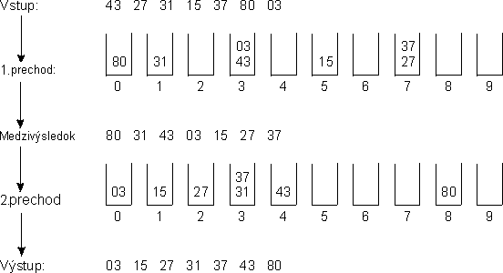
Fig: Example of radix/bucket sort

Slide 59
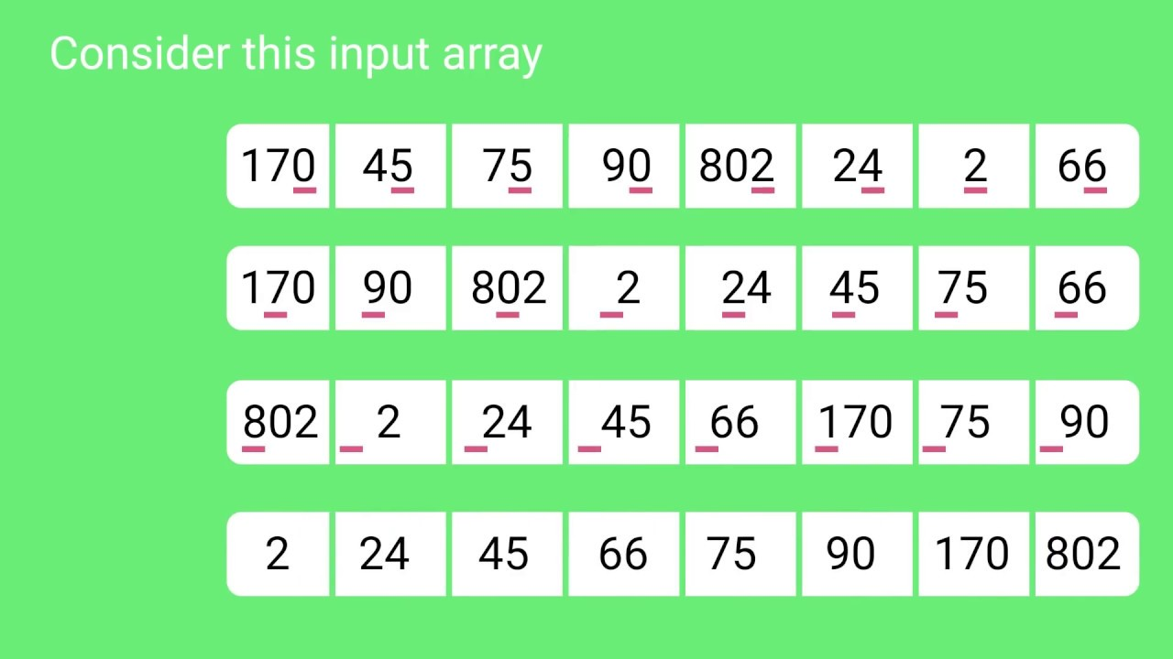
Fig: Example of radix sort

Slide 60
Advantages:
Radix sort algorithm is well known for its fastest sorting algorithm for numbers and even for strings of letters.
Radix sort algorithm is the most efficient algorithm for elements which are arranged in descending order in an array.
Disadvantages:
The speed of Radix Sort largely depends on the inner basic operations, and if the operations are not efficient enough, Radix Sort can be slower than some other algorithms such as Quick Sort and Merge Sort.
Radix sort is not good with different kind of data, but when you want to sort unsigned int and you want are doing the sort on a multi-core processor like GPU, radix sort is faster.

Slide 61
Shell sort:
Shell sort, invented by Donald shell in 1959, is a sorting algorithm that is a generalization of insertion sort. While discussing insertion sort we have observed two things:
i) First, insertion sort works well when the input data is ‘almost sorted’.
ii) Second, insertion sort is quite inefficient to use as it moves the values just one position at a time.

Slide 62
Shell sort is an algorithm that first sorts the elements far apart from each other and successively reduces the interval/gap between the elements to be sorted.
It is a generalized version of insertion sort.
In shell sort, elements at a specific interval are sorted. The interval/gap between the elements is gradually decreased based on the sequence used.
The performance of the shell sort depends on the type of sequence used for a given input array.
Important point/formula is:
Interval/Gap=floor(N/2) where N= no. of elements in an array

Slide 63
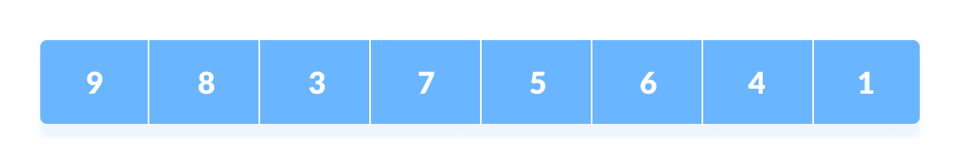
How Shell Sort Works?
Suppose, we need to sort the following array.
2. In the first pass, if the array size is N = 8 then, the elements lying at the interval/gap of N/2 = 4 are compared and swapped if they are not in order.
The 0th element is compared with the 4th element.
If the 0th element is greater than the 4th one then,
the 4th element is first stored in temp variable and the
0th element (ie. greater element) is stored in the 4th position and
the element stored in temp is stored in the 0th position.

Slide 64
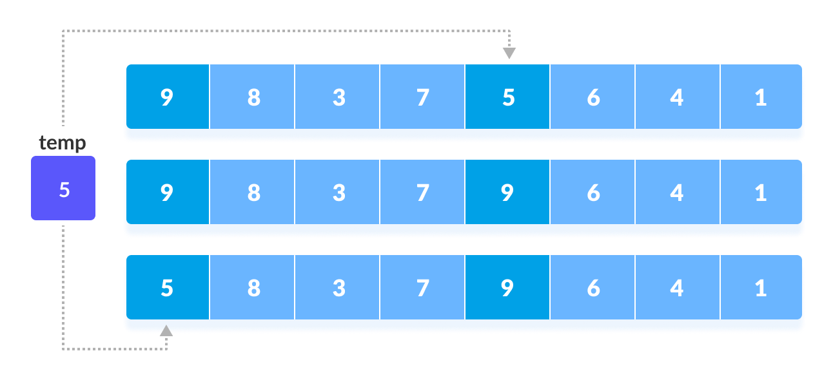

Slide 65
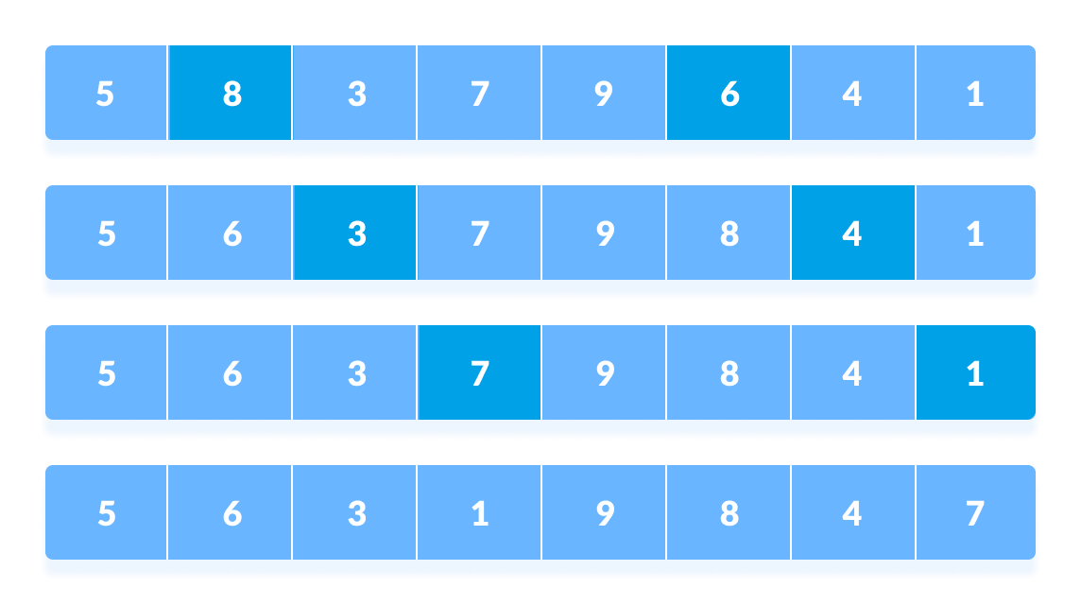
This process goes on for all the remaining elements.

Slide 66
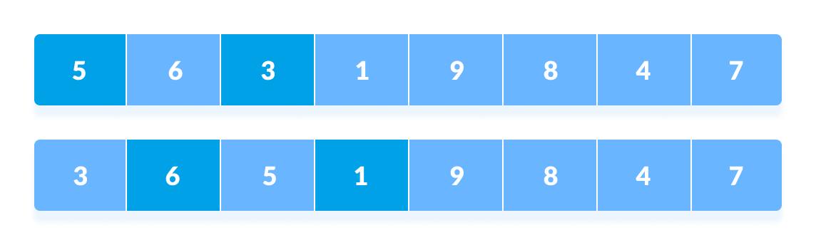
3. In the second pass, an interval of N/4 = 8/4 = 2 is taken and again the elements lying at these intervals are sorted.

Slide 67
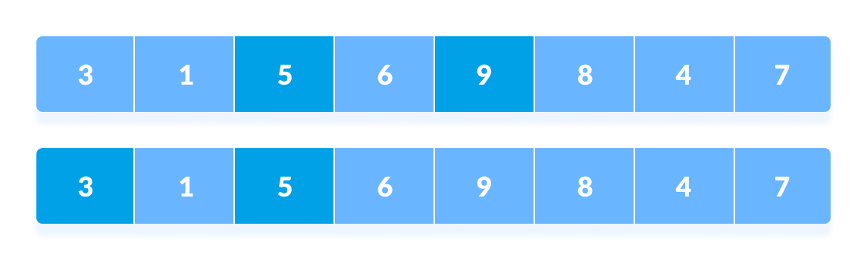
The elements at 4th and 2nd position are compared. The elements at 2nd and 0th position are also compared. All the elements in the array lying at the current interval are compared.

Slide 68
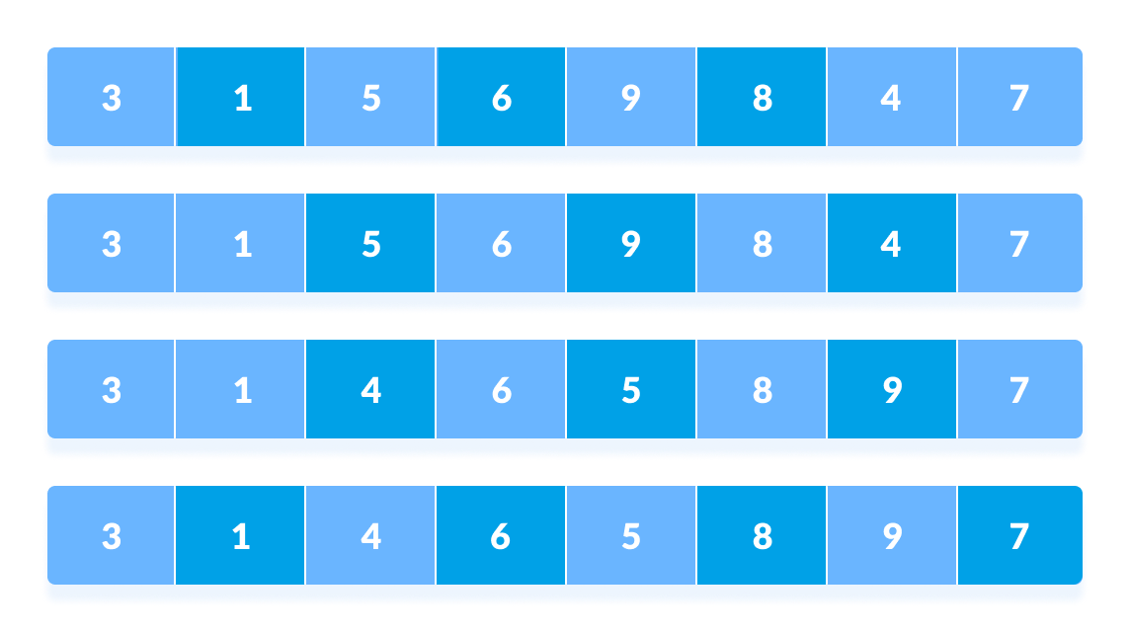
4. The same process goes on for remaining elements

Slide 69
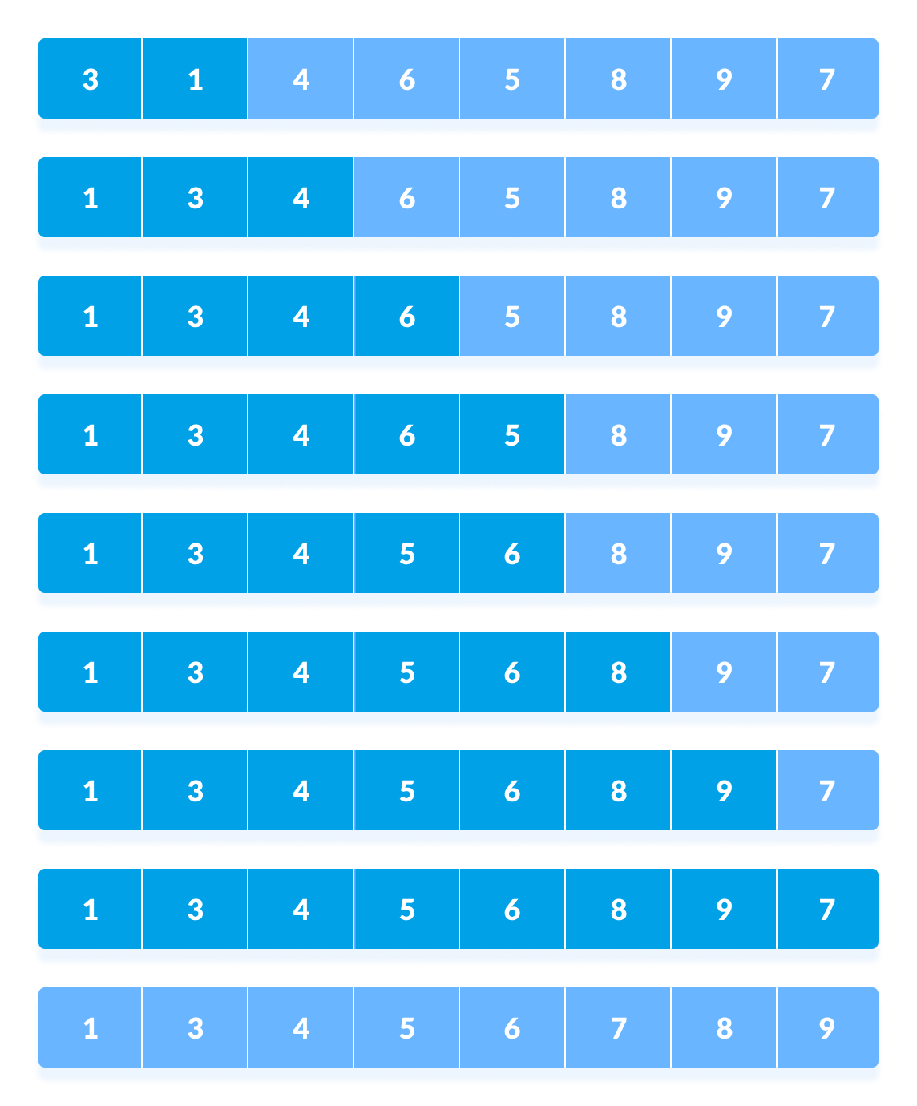
5. Finally, when the interval is N/8 = 8/8 =1 then the array elements lying at the interval of 1 are sorted. The array is now completely sorted.

Slide 70
Examples of shell sort:
1) 4,3,7,1,8,5
2) 60,20,30,10,50,40
3) 12,4,67,23,90,46,78
4) 77,62,14,9,30,21,80,25,70,55

Slide 71
Exercise problems on Shell sort:
1) 14,19,27,10,35,33,42,44
2) 17,26,93,44,77,31,54,55,20
3) 12,4,3,9,18,7,2,17,13,1,5,6
4) 18,32,12,5,38,33,16,2
5) 34,12,20,7,13,15,2,23

Slide 72
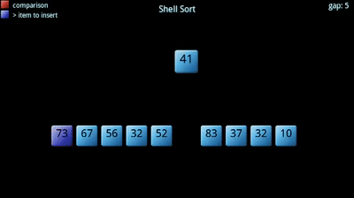
Fig: Example of shell sort

Slide 73


Slide 74
Searching means to find whether a particular value is present in an array or not. If the value is present in the array, then searching is said to be successful and the searching process gives the location of that value in the array.
However, if the value is not present in the array, the searching process displays an appropriate message and in this case searching is said to be unsuccessful.
There are two popular methods for searching the array elements:
(i) Linear search
(ii) Binary search
The algorithm that should be used depends entirely on how the values are organized in the array.

Slide 75
Linear search:
Linear search, also called as sequential search, is a very simple method used for searching an array for a particular value.
A Linear Search is the most basic type of searching algorithm.
It works by comparing the value to be searched with every element of the array one by one in a sequential until a match is found.
Linear search is mostly used to search an unordered list of elements(array in which data elements are not sorted).

Slide 76
Steps on how it works:
Here is simple approach is to do Linear Search:
Start from the leftmost element of array and one by one compare the element we are searching for with each element of the array.
If there is a match between the element we are searching for and an element of the array, return the index.
If there is no match between the element we are searching for and an element of the array, return -1.

Slide 77
Linear search Algorithm:
Linear Search ( Array A, Value x)
Step 1: Set i to 1
Step 2: if i > n then go to step 7
Step 3: if A[i] = x then go to step 6
Step 4: Set i to i + 1
Step 5: Go to Step 2
Step 6: Print Element x Found at index i and go to step 8
Step 7: Print element not found
Step 8: Exit

Slide 78
Example of linear search:
8,2,6,3,5
10,50,30,70,80,60,20,90,40
10,14,19,26,27,31,33,35,42,44

Slide 79
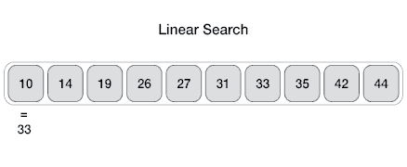
Fig: Example of linear search

Slide 80
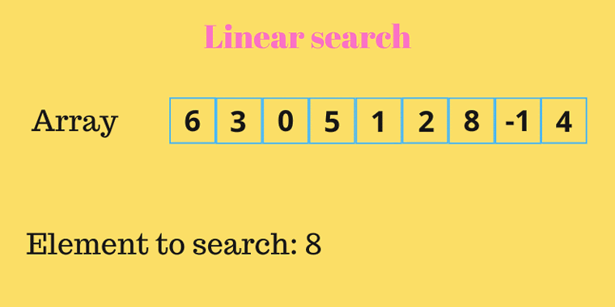
Fig: Example of linear search

Slide 81
Exercise problems:
10,8,1,21,7,32,5,11,0
11,21,30,54,92,90,87,17
45,23,89,58,12,34,51,20,80
10,60,50,40,20,30,70,90,80
45,67,10,34,21,30,67,49,90,28

Slide 82
Binary search:
Binary search is a searching algorithm that works efficiently with a sorted list.
The mechanism of binary search can be better understood by an analogy of a telephone directory.
When we are searching for a particular name in a directory, we first open the directory from the middle and then decide whether to look for the name in the first part of the directory or in the second part of the directory.
Again, we open some page in the middle and the whole process is repeated until we finally find the right name.

Slide 83
Binary search is an efficient algorithm for finding an item from a sorted list of items.
It works by repeatedly dividing in half the portion of the list that could contain the item, until you've narrowed down the possible locations to just one.
Binary Search is applied on the sorted array or list of large size. It's time complexity of O(log n) makes it very fast as compared to other sorting algorithms.
The only limitation is that the array or list of elements must be sorted for the binary search algorithm to work on it.

Slide 84
Binary search Algorithm:
BINARY_SEARCH(A, lower_bound, upper_bound, VAL)
Step 1: [INITIALIZE] SET BEG = lower_bound
END = upper_bound, POS = - 1
Step 2: Repeat Steps 3 and 4 while BEG <=END
Step 3: SET MID = (BEG + END)/2
Step 4: IF A[MID] = VAL
SET POS = MID
PRINT POS
Go to Step 6
ELSE IF A[MID] > VAL
SET END = MID - 1
ELSE
SET BEG = MID + 1
[END OF IF]
[END OF LOOP]
Step 5: IF POS = -1
PRINT "VALUE IS NOT PRESENT IN THE ARRAY"
[END OF IF]
Step 6: EXIT

Slide 85
Example of Binary search:
2,5,8,12,16,23,38,56,72,91
1,2,4,7,8,10,11,13,14,15
6,12,17,23,38,45,77,84,90
1,5,7,12,13,16,17,22,24

Slide 86
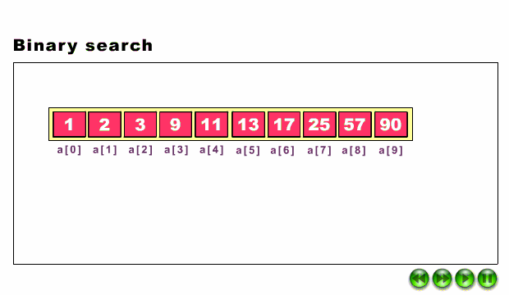
Fig: Example of Binary search

Slide 87
Exercise problems:
15,27,33,83,92,99
2,6,9,11,12,22,32,43
26,35,38,41,46,50,51,54,56
1,3,12,14,23,34,55,65,75,78
4,5,10,15,20,25,30,35,40,45,50,58,65,80,98

Slide 88
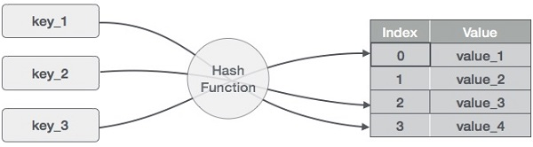
Hashing:
Hashing is a technique to convert a range of key values into a range of indexes of an array.
We're going to use modulo operator to get a range of key values. Consider an example of hash table of size 10, and the following items are to be stored. Item are in the (key,value) format.

Slide 89
Some examples of how hashing is used in our lives include:
In universities, each student is assigned a unique roll number that can be used to retrieve information about them.
In libraries, each book is assigned a unique number that can be used to determine information about the book, such as its exact position in the library or the users it has been issued to etc.
In both these examples the students and books were hashed to a unique number.

Slide 90
Hash table:
Hash table is a data structure in which keys are mapped to array positions by a hash function.
A value stored in a hash table can be searched in O(1) time by using a hash function which generates an address from the key(by producing te index of the array whether the value is stored).
In a hash table, data is stored in an array format, where each data value has its own unique index value. Access of data becomes very fast if we know the index of the desired data.

Slide 91
Basic Operations:
Following are the basic primary operations of a hash table.
1) Search − Searches an element in a hash table.
2) Insert − inserts an element in a hash table.
3) delete − Deletes an element from a hash table.

Slide 92
Hash function:
A hash function is a mathematical formula which,when applied to a key, produces an integer which can be used as an index for the key in the hash table.
The main aim of ash function is that elements should be relatively, randomly, and uniformly distributed.
It produces a unique set of integers within some suitable range in order to reduce the number of collisions.
In practice, there is no hash function that eliminates collisions completely.
A good hash function can only minimize the number of collisions by spreading the elements uniformly throughout the array.

Slide 93
Properties of a Good Hash Function:
Low cost: The cost of executing a hash function must be small, so that using the hashing technique becomes preferable over other approaches.
Determinism: A hash procedure must be deterministic. This means that the same hash value must be generated for a given input value. However, this criteria excludes hash functions that depend on external variable parameters (such as the time of day) and on the memory address of the object being hashed (because address of the object may change during processing).
Uniformity: A good hash function must map the keys as evenly as possible over its output range. This means that the probability of generating every hash value in the output range should roughly be the same. The property of uniformity also minimizes the number of collisions

Slide 94
DIFFERENT HASH FUNCTIONS:
we will discuss the hash functions which use numeric keys. However, there can be cases in real-world applications where we can have alphanumeric keys rather than simple numeric keys. In such cases, the ASCII value of the character can be used to transform it into its equivalent numeric key. Once this transformation is done, any of the hash functions given below can be applied to generate the hash value.
1. Division Method
2. Multiplication Method
3. Mid-Square Method
4. Folding Method

Slide 95
Division Method:
It is the most simple method of hashing an integer x. This method divides x by M and then uses the remainder obtained. In this case, the hash function can be given as
h(x) = x mod M
The division method is quite good for just about any value of M and since it requires only a single division operation, the method works very fast. However, extra care should be taken to select a suitable value for M.

Slide 96
COLLISIONS:
Collisions occur when the hash function maps two different keys to the same location. Obviously, two records cannot be stored in the same location. Therefore, a method used to solve the problem of collision, also called collision resolution technique, is applied. The two most popular methods of resolving collisions are:
1. Open addressing
2. Chaining

Slide 97
Collision Resolution by Open Addressing:
Once a collision takes place, open addressing or closed hashing computes new positions using aprobe sequence and the next record is stored in that position.
In this technique, all the values are stored in the hash table. The hash table contains two types of values: sentinel values (e.g., –1) and data values.
The presence of a sentinel value indicates that the location contains no data value at present but can be used to hold a value.
The process of examining memory locations in the hash table is called probing. Open addressing technique can be implemented using linear probing, quadratic probing, double hashing, and rehashing.

Slide 98
Linear Probing:
The simplest approach to resolve a collision is linear probing. In this technique, if a value is already stored at a location generated by h(k), then the following hash function is used to resolve the collision:
h(k, i) = [h'(k) + i] mod m
Where m is the size of the hash table, h'(k) = (k mod m), and i is the probe number that varies from 0 to m–1.Therefore, for a given key k, first the location generated by [h'(k) mod m] is probed because for the first time i=0.
If the location is free, the value is stored in it, else the second probe generates the address of the location given by [h'(k) + 1]mod m. Similarly, if the location is occupied, then subsequent probes generate the address as [h'(k) + 2]mod m, [h'(k) + 3]mod m, [h'(k) + 4]mod m, [h’(k)+ 5]mod m, and so on, until a free location is found.

Slide 99
Quadratic Probing:
In this technique, if a value is already stored at a location generated by h(k), then the following hash function is used to resolve the collision:
h(k, i) = [h'(k) + c1.i + c2.i^2] mod m
where m is the size of the hash table, h'(k) = (k mod m),
i is the probe number that varies from 0 to m–1, and c1 and c2 are constants such that c1 and c2 π 0.
Quadratic probing eliminates the primary clustering phenomenon of linear probing because instead of doing a linear search, it does a quadratic search.

Slide 100
Double Hashing:
To start with, double hashing uses one hash value and then repeatedly steps forward an interval until an empty location is reached. The interval is decided using a second, independent hash function, hence the name double hashing.
In double hashing, we use two hash functions rather than a single function. The hash function in the case of double hashing can be given as:
h(k, i) = [h1(k) + ih2(k)] mod m
where m is the size of the hash table, h1(k) and h2(k) are two hash functions given as h1(k) = k mod
m, h2(k) = k mod m', i is the probe number that varies from 0 to m–1, and m' is chosen to be less than
m. We can choose m' = m–1 or m–2.

Slide 101
Rehashing:
When the hash table becomes nearly full, the number of collisions increases, thereby degrading the performance of insertion and search operations.
In such cases, a better option is to create a new hash table with size double of the original hash table.
All the entries in the original hash table will then have to be moved to the new hash table.
This is done by taking each entry, computing its new hash value, and then inserting it in the new hash table.
Though rehashing seems to be a simple process, it is quite expensive and must therefore not be done frequently.
Consider the hash table of size 5 given below. The hash function used is h(x)= x % 5. Rehash the entries into to a new hash table.

Slide 102
Collision Resolution by Chaining:
In chaining, each location in a hash table stores a pointer to a linked list that contains all the key values that were hashed to that location.
That is, location l in the hash table points to the head of the linked list of all the key values that hashed to l. However, if no key value hashes to l, then location l in the hash table contains NULL.

Slide 103
Operations on a Chained Hash Table:
Searching for a value in a chained hash table is as simple as scanning a linked list for an entry with the given key.
Insertion operation appends the key to the end of the linked list pointed by the hashed location.
Deleting a key requires searching the list and removing the element.

Slide 104
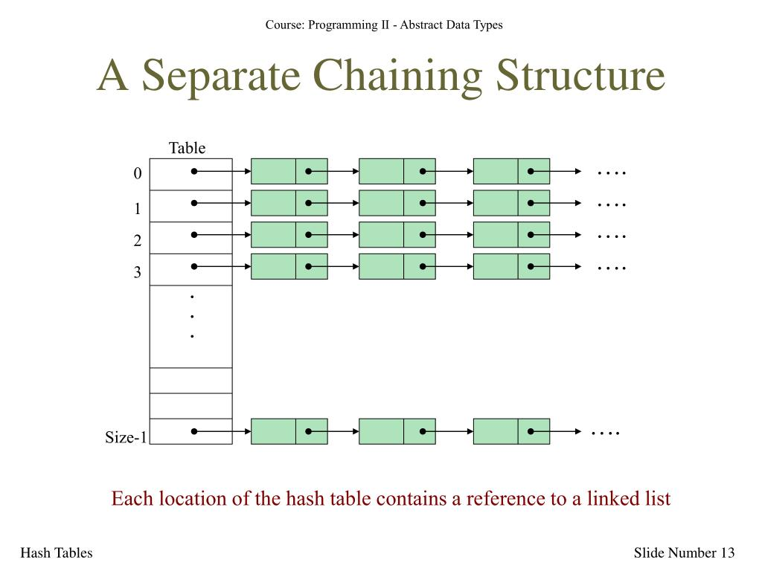

Slide 105
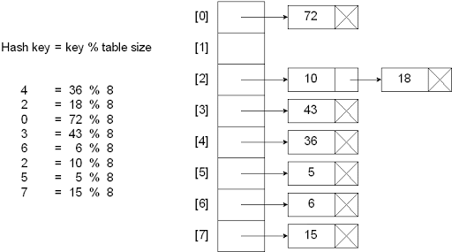
Fig: Example problem on hash table with chaining

Slide 106
Bucket Hashing:
In closed hashing, all the records are directly stored in the hash table. Each record with a key value k is stored in a location called its home position.
The home position is calculated by applying some hash function.
In case the home position of the record with key k is already occupied by another record then the record will be stored in some other location in the hash table.

Slide 107
This other location will be determined by the technique that is used for resolving collisions.
Once the records are inserted, the same algorithm is again applied to search for a specific record.
One implementation of closed hashing groups the hash table into buckets where M slots of the hash table are divided into B buckets.
Therefore, each bucket contains M/B slots. Now when a new record has to be inserted, the hash function computes the home position. If the slot is free, the record is inserted.

Slide 108
Otherwise, the bucket’s slots are sequentially searched until an open slot is found. In case, the entire bucket is full, the record is inserted into an overflow bucket.
The overflow bucket has infinite capacity at the end of the table and is shared by all the buckets.

Slide 109
Real World Applications of Hashing:
1. CD Databases
2. Drivers Licenses/Insurance Cards
3. Sparse Matrix
4. File Signatures
5. Game Boards

Slide 110


